Slide 1

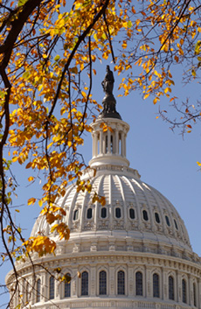
North Star Intellectual Property Law
The IP Factor: Patents Provide
Proprietary Protection
April 26, 2016
1120 Connecticut Avenue, NW, Suite 304
Washington, DC 20036
T: 202-429-0020
F: 202-315-3758
E: info@nsiplaw.com
www.nsiplaw.com

Slide 2
Outline of Topics
Introduction to the Patent System
Structure of a Patent: A Mechanical Example
Overview of the Process of Obtaining a Patent
Overview of the Process of Enforcing a Patent
Patents in Electronic Technology
Patents in Biochemical Technology
Perspectives on Patents
  Small Inventors/Universities/Government
  Venture Capitalists/Investors/Non-Practicing Entities
  Established Companies
Recent Developments (USPTO/Courts/Congress)
International Aspects of Patents
Conclusion

Slide 3

Do You Have an Innovative Invention?
Innovation has taken on a key role in business competitiveness and in economic growth as a whole.
Innovation takes on many forms, ranging from highly specialized technology to branding to creative content.
Innovation requires an investment by its creator, usually including time, money, and effort. However, many innovations, once developed, are relatively easy for competitors to replicate without the initial investment required to create the innovation.
Therefore, in order to encourage innovation, it is suitable for governments to intervene to protect the interests of the innovators.
Innovative Idea → Commercialization…IP Helps Innovators Recoup Costs for:
    Research & Development (Basic and Applied)
    Market Research
    Investment
    Manufacturing/Implementing
    Marketing and Capitalizing

Slide 4

Stages of Invention
Invention begins with conception of an inventive concept.
However, development of such an inventive concept often requires expensive research to develop and to proceed from invention to a marketable, working invention.
It is essential for there to be a way for inventors to control others’ access to the technologies that they develop.
Research into sophisticated electronic technology is extremely expensive. Without control over initial access to a drug or technology, it would be difficult for the originating company to recoup its investment.
Unless exclusivity for a new invention can be enforced, the value of new ideas is significantly curtailed.

Slide 5

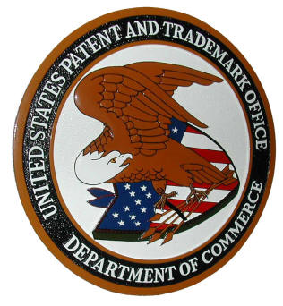
Introduction to Patents
In General, a Patent = Government Granted Right to Exclude Others from Making, Using or Selling Your Invention for a Limited Time
Due to this Right, a Patent Owner has a limited Monopoly on the patented technology, which allows them to have enhanced control of the use of their technology. In exchange, the patentee is required to provide sufficient disclosure that other parties are able to understand the nature of the technology that is patented and use it to spur further innovation.
    Patent is granted by one country to an inventor.
    There are no international patents. Patents must be filed in each country where protection is sought. Additionally, various countries have different policies about aspects of patents they will allow, such as differing treatment of certain technologies.
    Certain Treaties exist to help coordinate obtaining patent protection for the same technologies in multiple countries.
    Patent rights are limited in duration to avoid a perpetual monopoly on technologies.
    In general, Patents include a Specification and Drawings to allow others to understand the technology, as well as Claims that establish the legal right that the Patent holder is asserting.

Slide 6
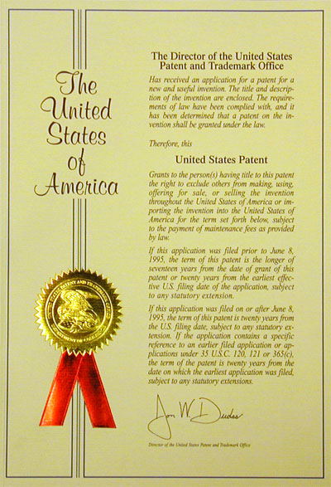
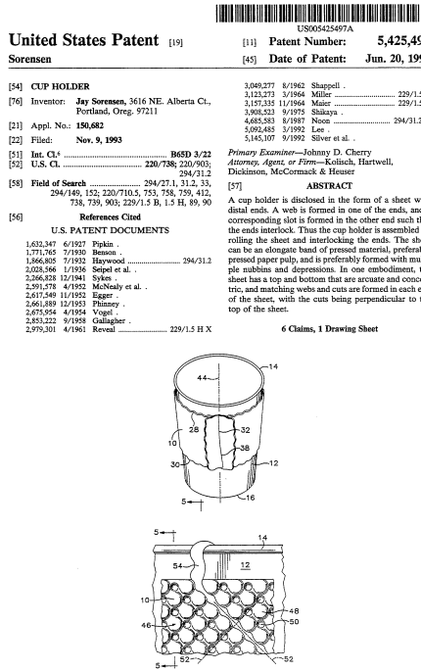
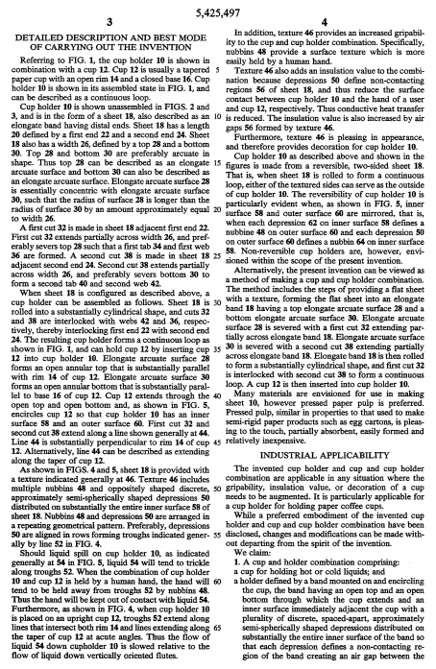
Introduction to Patents (USA)
    Patent is granted by Federal Government to an inventor.
    Patent rights are limited in duration (20 years from filing).
    ALERT! Because the U.S. is now first-to-file, it is extremely important to pursue patent protection, if desired, before public disclosure.
    Authority to grant patents based on Constitution (Article One, Section 8, Clause 8): “The Congress shall have power ... To promote the progress of science and useful arts, by securing for limited times to authors and inventors the exclusive right to their respective writings and discoveries.”

Slide 7



What Alternatives are there to Protect Innovation? (Other IP)
Patents are one form of IP (Intellectual Property), which allows creators and inventors to obtain government granted rights to provide them with the control of their innovation.
Other Forms:
  Copyright: Grants the creator of an original work exclusive rights for its use and distribution. This is usually only for a limited time. The exclusive rights are not absolute but limited by limitations and exceptions, including fair use. Copyright protects only the original expression of ideas, and not the underlying ideas themselves. For example, copyright can protect computer code, but not an underlying algorithm.
  Trademark/Servicemark: A recognizable sign, design, or unique expression related to products or services of a particular source from those of others. Protectable to avoid consumer confusion.
  Trade Secret: A trade secret is a formula, practice, process, design, instrument, pattern, commercial method, or compilation of information which is not generally known or reasonably ascertainable by others, and by which a business can obtain an economic advantage over competitors or customers. Trade secrets are protected by controlling access to the information and signing contracts to penalize unauthorized disclosure.
  Design Patent: A Design Patent is a different form of Patent , directed towards protecting an ornamental design.

Slide 8


Patents are Worth a Lot of $$$
Lipitor brought in $131 Billion for Pfizer when under patent.
Patents Helped Open Markets to Lightbulb, Airplane, Phonograph.
Median Patent Damages at Trial were $2.9 Million from 2010-2014.
Damage Awards have exceeded $1.5 Billion (Arthritis Drugs; MP3 Technology); $1 Billion (Noise Reduction for Disk Drives; Smartphone Software, GMO Soybeans); and $400-500 Million (Operating System Software; Stents; Internet Browser; Blood Oxygen Measurement Device).
In 2014 Meditronic settled patent litigation with Edwards Liifesciences over heart valves for approximately $1.15 Billion.
Google Bought Motorola Mobility for $12.5 Billion in 2011; Much of Value was Patent Portfolio.
In 2013 Microsoft made $3.4 Billion from Licensing Android-Related Smartphone Patents to Samsung.
Patents also sometimes allow injunctions to block use/sale of infringing goods, and the International Trade Commission (ITC) can block importation of infringing imports.

Slide 9
Structure of a Patent: A Mechanical Example
Parts of a Patent
Title of the invention
Drawings
Inventor
Assignee (Patent Owner)
Issue Date of Patent
Background of the invention.
Brief summary of the invention.
Brief description of the several views of the drawing.
Detailed description of the invention.
A claim or claims.
Abstract of the disclosure
www.google.com/patents

Slide 10
Structure of a Patent: A Mechanical Example
What about the Patent Expiration Date?
Calculated from publically available information
20 years from filing date (17 years from issue if filed before June 1995)
Patent Term Adjustment
Maintenance Fee (USPTO website)

Slide 11

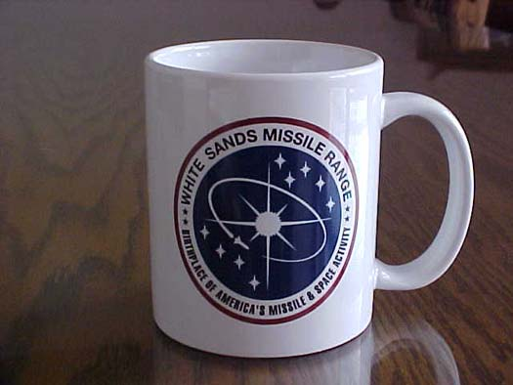
Structure of a Patent: A Mechanical Example
Claims
A claim is a patentee’s statement of what his or her invention is.
A claim defines the scope of patent protection by stating what features must be present in a product to be covered by the patent .
A patent gives a patentee a right to exclude others from selling, importing into the U.S., or using a patented invention as defined by the claims of the patent. 35 USC § 271.
  A cup holder, comprising a band that encircles a cup to reduce the rate of heat transfer between a liquid in the cup and a hand gripping the band.
  The holder of claim 1, wherein the band comprises a paper band.
  [Claims have been simplified for illustrative purposes]

Slide 12
Protecting Mechanical Technologies
Many sole inventors and corporations have come up with great mechanical inventions.
  Ex) Ketchup valve technology, Callahan envelope with windows
Paper Patent Doctrine: An inventor does not need to make a physical prototype of the invention before filing a patent application .
Drawings are required where necessary for understanding of the technology.
The patent disclosure must be sufficient to allow another person to make the invention. Terms of claims will be interpreted in light of the specification. Careful choice of words, and consistent use of terms are important for ensuring broad claim scope.
Patent No. 701839

Slide 13
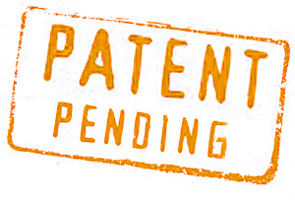
How Do I Obtain a Patent on an Invention?
Obtaining a Patent or prosecution of a patent application, includes:
Develop an innovative concept for the invention
  Often patent applications are invented as a part of research and development (R & D) by scientists, engineers, or independent inventors. Sometimes patent applications are inspired by an sudden inspiration, or even by accident!
  Sometimes, patent applications are invented by technically inexperienced inventors who develop an innovative concept, and translated into a technical innovation with the help of scientists and engineers.
  Note that patents are not directed to a product or an idea…patents protect specific technical aspects of an invention defined by claims, and often protect an incremental improvement rather than a completely new technology.
  OK, now we’re ready to prepare an application for consideration by the U.S.P.T.O.! Note that in order to be eligible for patent protection, not only conception but reduction to practice is required. However, a sufficiently detailed patent application will itself serve as a form of reduction to practice.

Slide 14

How Do I Obtain a Patent on an Invention?
Obtaining a Patent, referred to as prosecution of a patent application, includes several stages:
Prepare an Application
  Find a good patent attorney While it is possible to draft and prosecute your own application (referred to as pro se), it is generally advisable to go to an attorney who is experienced with how to draft applications and has a good understanding of the relevant technology.
  Consider filing a provisional patent application. Such an approach requires the payment of fewer government fees and is often cheaper in that it allows a placeholder application that allows a one-year time period to decide whether to proceed.
  The inventors provide disclosure of the invention to the attorney. This may involve a discussion with the inventors, sharing of lab journals and research papers. Often the attorney will need to ask questions of the inventors to ensure that the application accurately represents the inventors’ work.
  The patent attorney then drafts the application. Usually, the patent attorney includes drawings in the application as well, which may include preparation by an experienced draftsperson.
  Usually, the patent attorney consults with the client (who may be in-house counsel or a business owner) for approval to finalize the application.
  File!
  OK, now we’re ready prosecute before the U.S.P.T.O.!

Slide 15

How Do I Obtain a Patent on an Invention?
Obtaining a Patent, referred to as prosecution of a patent application, includes several stages:
Prosecute the Application (Part I)
  The USPTO reviews the application to ensure it is complete and does not have major problems, such as missing drawings. Then, it is classified and assigned to an Examiner. This initial process can take a few months to over a year.
  The Examiner considers the application. The Examiner will check to make sure that there are no formal issues, such as with the Drawings or Specification. However, the main issues are patentable subject matter (35 U.S.C. §101) enablement/written description/indefiniteness (35 U.S.C. §112), novelty (35 U.S.C. §102), and nonobviousness (35 U.S.C. §103). The last two are directed to whether the subject of the application was disclosed or obvious to one of ordinary skill based on combining known technologies, available prior to the filing date of the application.

Slide 16

How Do I Obtain a Patent on an Invention?
Obtaining a Patent, referred to as prosecution of a patent application, includes several stages:
Prosecute the Application (Part II)
  The Examiner may, at this point, allow the application if no issues are identified. However, usually the Examiner issues a Non-Final Office Action.
  Problems with the Specification and Drawings lead to Objections. For example, if the drawings are incorrectly numbered or if the Specification includes a typographical error the Examiner will present an Objection.
  35 U.S.C. §101 (discussed further later) establishes that the claims are directed to a statutory class (process, machine, manufacture, or composition) and are new and useful. There are certain judicial exclusions under this statue which may lead to rejections for an attempt to claim an “abstract idea” or “law of nature.” Hence, it is important to claim technologies to avoid problems.
  35 U.S.C. §112 is largely directed to the form and content of the application. This statute first requires sufficient enablement and written description, ensuring that the application sufficiently discloses and explains the subject matter claimed.

Slide 17

How Do I Obtain a Patent on an Invention?
Obtaining a Patent, referred to as prosecution of a patent application, includes several stages:
Prosecute the Application (Part III)
  35 U.S.C. §112 also deals with certain other formal matters. The claims must be clear and definite. 35 U.S.C. §112 also discusses the use of “means-plus-function” claims, which provide an approach in which the claims recite “means for” doing certain things, and then the Specification clarifies how these operations are accomplished.
  Other rejections are based on novelty with respect to prior art (35 U.S.C. §102) or obviousness with respect to combinations of prior art (35 U.S.C. §103).
  Prior to the America Invents Act (made law in 2011), the U.S. was based on a “first-to-invent” model, and the references that could be used as “prior art” were constrained by considering the date of invention. As of March 16, 2013, applications are subject to “first-to-file” requirements and hence it has become very important to file as soon as possible and minimize public disclosure until a patent application has been filed.

Slide 18


How Do I Obtain a Patent on an Invention?
Obtaining a Patent, referred to as prosecution of a patent application, includes several stages:
Prosecute the Application (Part IV)
  Novelty rejections (35 U.S.C. §102) are based on arguments that a prior art reference discloses, explicitly or inherently, all features of a claim.
  Obviousness rejections with respect to prior art (35 U.S.C. §103) are based on arguments that one or more pieces prior art, when combined, would have caused al of the features of a claim to be taught or suggested. While Court decisions have made it easier to combine references in such a rejection, such rejections can be argued based on factors such as “improper hindsight” or “teaching away,” if the separate elements are taught by the prior art, but it would be problematic to combine the elements.
  Once the Office Action has been presented, the Attorney prepares a Response. A Response can include amendments to the claims or other parts of the Application that address the Examiner’s Objections and Rejections without adding new matter. The Response can also include appropriate arguments that the Applicants disagree with the Examiner’s Objections and Rejections, and attempt to convince the Office that the Objections and Rejections should be withdrawn.

Slide 19

How Do I Obtain a Patent on an Invention?
Prosecution Structure (Terminates with Allowance or Abandonment)
File Application & Resolve any Pre-Exam Issues
Restriction May Be Required for Applications Allegedly Directed to Multiple Inventions
Receive Non-Final Office Action (or First Office Action Allowance)
Submit Response to Non-Final Office Action
Allowance or Final Office Action (Based on Response)
Optional After-Final Response with Optional After Final Pilot Request
Allowance or Advisory Action (Based on After-Final Response)
Request for Continued Examination (RCE) or Notice of Appeal
  If RCE, After-Final Response is Entered and Considered; Application will be Allowed or Receive New Office Action
  If Notice of Appeal, Applicant may optionally File Pre-Appeal Brief; Otherwise Applicant Files Appeal Brief; Receives Examiner’s Answer; May Present Optional Reply Brief and Oral Arguments; PTAB (Patent Trials and Appeals Board) Reviews Cases and Returns to Examiner Based on Decision; RCE Possible at Any Point in Appeal Process

Slide 20

How Do I Obtain a Patent on an Invention?
Prosecution Notes
Applicants may also request telephonic interviews and/or personal interviews; Access to interviews is best before Final Office Action and is not available after Appeal has been initiated.
Extensions of Time are available throughout process; Should Be Avoided to Maximize Patent Term.
Once Allowance has Occurred, Applicant has a 3-month non-extendible period to pay Issue Fee.
Applicants also have a Duty of Disclosure to Share Material Information they are aware of during prosecution.

Slide 21

How Much Does Preparation/Prosecution Cost?
There are four main groups of fees in obtaining a patent, which are the attorneys’ fees and government fees for preparing and filing the patent application, and the attorneys’ fees for prosecuting the patent and paying other government fees that arise in prosecution, such as paying if fees for additional examination or extension of time fees are necessary, and for paying an issue fee when the patent application is allowed.
Attorneys’ fees for preparing an application can vary widely, from $5,000-$10,000 for a very simple mechanical invention, to $15,000-$20,000 or more for a complicated electronic/software invention.
Part of the cost of preparing an application is based on the need for high-quality illustrations. Also, it may be desirable to spend a certain amount of money by performing a search prior to filing the patent application to help guarantee that the patent application takes into account existing technologies that may be cited by the Office.

Slide 22

How Much Does Preparation/Prosecution Cost?
Filing fees for an application are generally $1,000-$2,000.
Many government fees are reduced for “small entity” or “micro-entity” applicants.
If an application has many claims or is extremely lengthy, these may require additional fees.
The relatively new “Track One” program provides a way to accelerate the prosecution of an application that is high priority by spending additional money for prioritized consideration of the application.
Prosecution generally requires payment of legal fees (a couple of $1,000s) for the attorney to analyze the Office Actions and draft Responses. The Office will charge if a Request for Continued Examination (RCE), as described above, is necessary.

Slide 23
Overview of the Process of Using a Patent
Assignment: a contract to transfer ownership of a patent. Every patent is first considered the property of an inventor. Thus, the document that assigns the patent right of an inventor to a company is also called an assignment.
Licensing: a contract between a licensor and a licensee to grant a right to practice the claimed technology in the licensed patent. The licensor agrees not to sue licensee for patent infringement.
Patent Infringement Lawsuit: a civil lawsuit in which a patent owner alleges another is making, using, selling or importing a patented item. In other words, the accused is infringing the patent owner’s patent. Such a lawsuit can be initiated in the Federal District Court.
Post Grant Proceeding: an administrative hearing before the U.S. PTO where a granted patent is challenged, usually as invalid or defective. (European equivalent is opposition proceeding).

Slide 24
Overview of the Process of Using a Patent
Tool for Negotiation
Licensing to Commercialize?
Locate a potential manufacturer / investor / distributor
Submit marketing materials
Negotiate terms of license
Types of License
Exclusive License: a patent owner transfers the right to practice invention to one party. The licensee may be even given the right to sue others to exclude them from the market.
Non-Exclusive License: a patent owner promises not to sue the licensee for practicing the invention. The patent owner can continue to practice the invention or to license to additional parties.
Cross-Licensing: two or more parties with patents grant each other rights to use each other’s patented technologies.

Slide 25
Overview of the Process of Using a Patent
Process of U.S. Patent Litigation
Complaint filed by a patent owner in a U.S. District Court (or ITC), alleging a patent has been infringed by a third party.
Defendant answers and/or asserts a counterclaim
Conference with a judge
Discovery: gathering of facts from both sides, deposition,
Claim construction hearing (Markman hearing) for interpreting claims of the patent.
Summary judgement motions
Pretrial brief
Jury trial
Verdict
Appeal to Court of Appeals or Federal Circuit
Approximate cost: $600K to $ 5 millions, depending on patent value

Slide 26
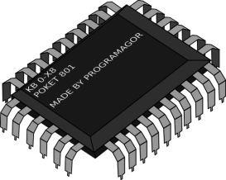
Protecting Electronic Technologies
Electronic Technologies encompass a huge variety of hardware technologies, including circuits, power supplies, components, light sources, audio technologies, batteries, communications components (wired and wireless), processors, storage media, video technologies, transistors, cameras, sensors, motors, generators, microwave ovens, transformers, and so on.
Other technologies that are patentable that are often considered as electronic technologies are technologies related to computing. Computing technologies range from technologies that are clearly and inextricably directed to hardware, such as semiconductor manufacturing technologies, used to produce computer chips for processors or differing types of memory, or circuit architectures used in processors, or technologies for memory, such as hard drives, optical storage, RAM, or flash memory.

Slide 27
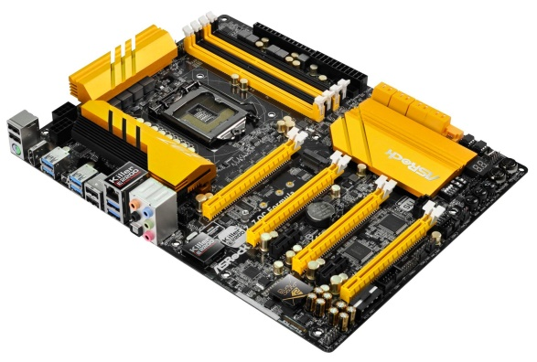
Protecting Electronic Technologies
Broader Technologies, Clearly Hardware
Other electronics technologies are clearly hardware-related, but operate at a higher level of abstraction. For example, technologies related to operations such as network communications, graphics processing, memory management, and so on are clearly based on specialized hardware configuration. These technologies are not claimed at the level of individual circuit elements or logic gates, but are claimed by showing relationships between hardware elements in embodiments.
In purely electronics technologies, claims generally specify structural components whose structural characteristics accomplish a goal.
In computing technologies, claims are often directed to a process or use structural elements “configured to” do things to accomplish a goal, such as maximizing network bandwidth, improving graphics performance, or optimizing battery use.

Slide 28

Protecting Electronic Technologies
Software per se, such as an algorithm or computer code is not patentable (although code is potentially protected by copyright).
However, “software”, when implemented as technology, such as by using specialized processors or components, can be patentable.
For example, approaches to data encryption and data compression are potentially patentable, if claimed properly as a method involving specialized hardware, or an apparatus including specialized elements.
Sometimes, software is claimed as a data storage medium that includes a record of steps that a processor would perform to perform a given computing task. Such claims need to be directed to a “non-transitory” medium.
It is also important to claim software so that there is a single actor. Because many network patents involve interaction between a client and a server, it may be necessary to claim the application from the client’s perspective and the server’s perspective separately so that a single party includes all of the steps/features of practicing the claim.

Slide 29
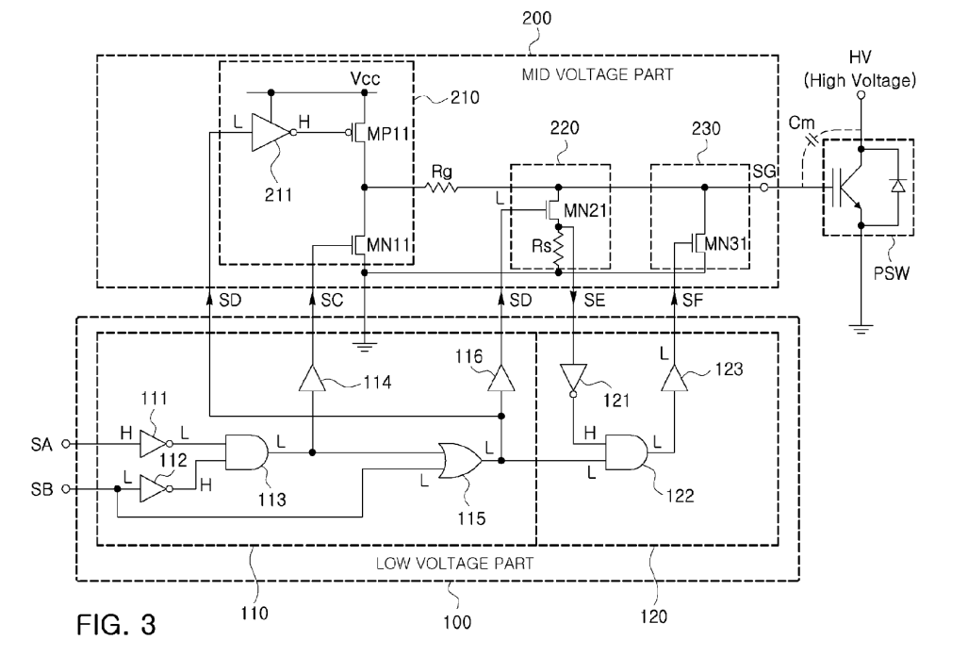
Protecting Electronic Technologies
Narrower Technologies (Circuits, Clearly Hardware, Samsung)
Example: 9,300,285 (GATE DRIVER CIRCUIT)

Slide 30
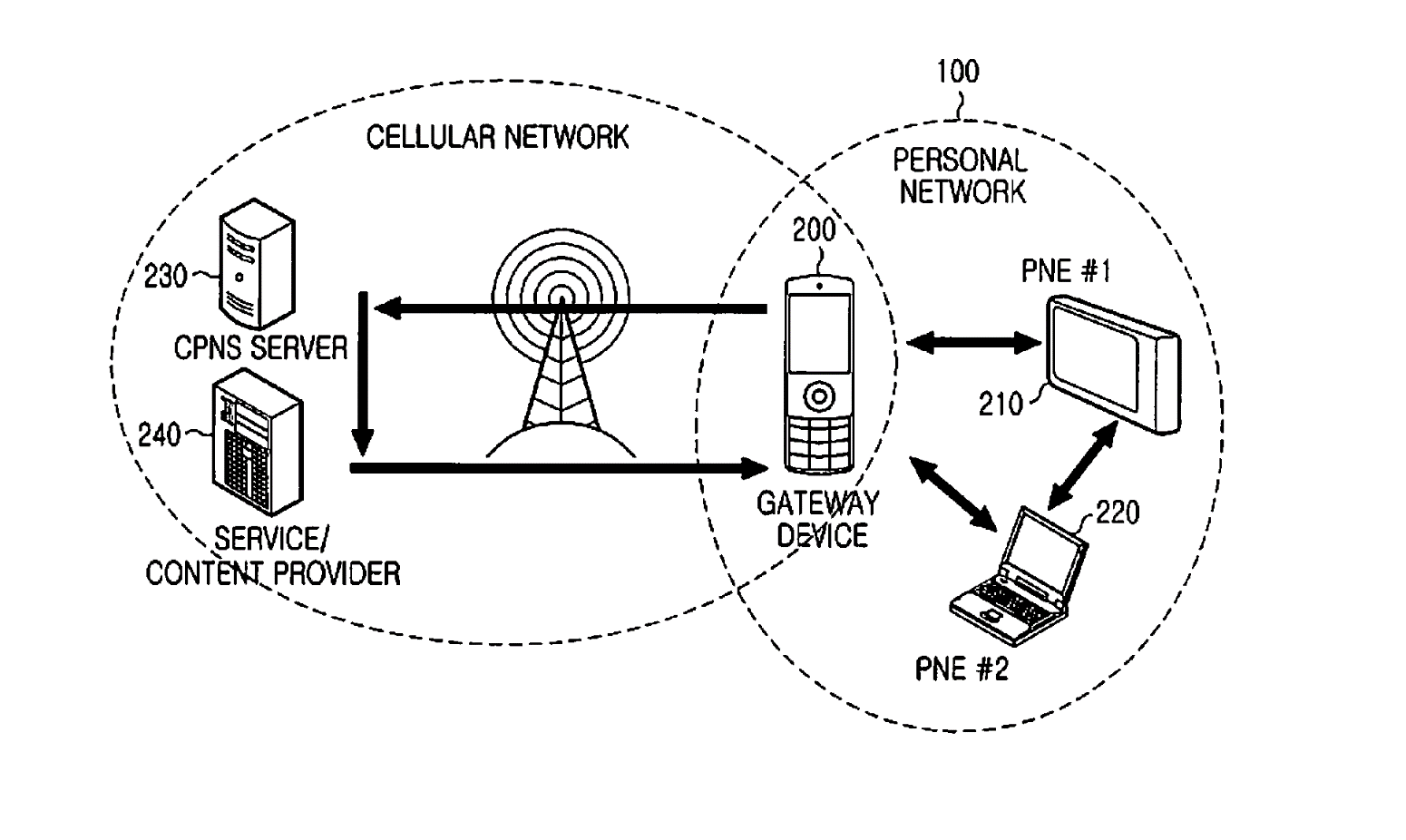
Protecting Electronic Technologies
Broader Technologies, Clearly Hardware (Samsung)
Example: 9,301,122 (APPARATUS AND METHOD FOR ESTABLISHING A PERSONAL NETWORK AND FOR PROVIDING A CPNS SERVICE)

Slide 31
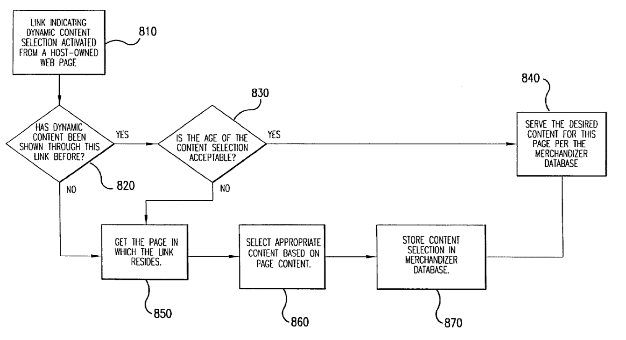
Protecting Electronic Technologies
Software Technologies, Internet Based (DDR Holdings)
Example: 6,993,572 (SYSTEM AND METHOD FOR FACILITATING INTERNET COMMERCE WITH OUTSOURCED WEBSITES)

Slide 32
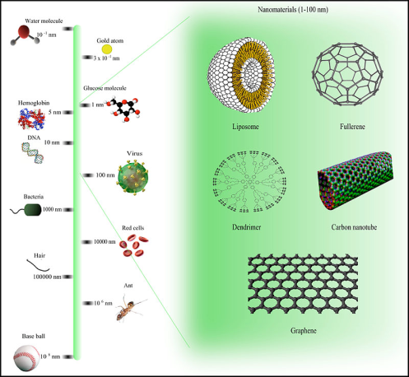
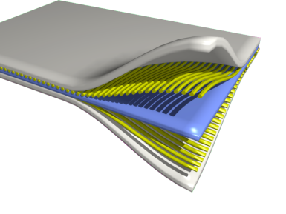
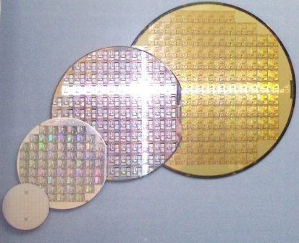
Protecting Chemical Technologies
Chemical Technologies encompass a variety of subject matters, including new materials, nanotechnology, semiconductor, computer chip, polymer, plastic films, battery, food additives, preservatives, petroleum products, composite, ceramic, chemical reactors, electronic components, and so on.
Common Category: Composition of Matter / Manufacturing Process
Challenges for Obtaining Patent:
Patent eligible subject matter: “composition of matter” or “process”
Strict enablement requirement applies to chemical arts. Patentees must demonstrate how to make the invention by providing working examples.
Novelty of invention may lay in sub-microscopic structures invisible to human eyes. Fingerprint claims are directed to characterizing inventions based on physical parameters rather than macroscopic structures.
Novelty of invention may lay with methods, high yields, purity of obtained substance, etc. TRIPS agreement has improved the protection of patent over process patents.
New use of old compounds may sometimes have to be protected. The circumstances of use should be carefully crafted to avoid inherency.

Slide 33
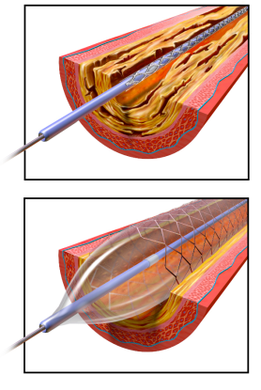
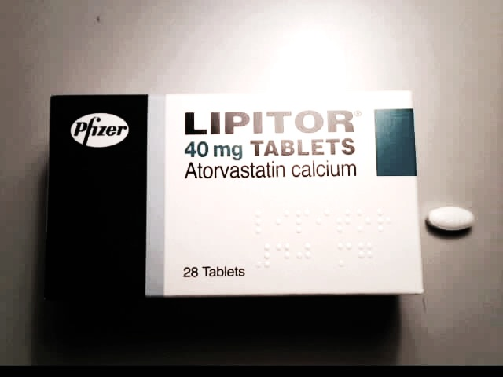
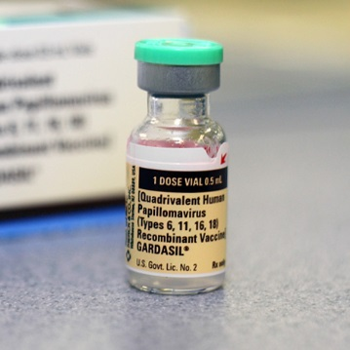
Protecting Life Science Inventions
Life Science inventions encompass a variety of subject matters, including pharmaceutical compounds known as small molecules (ex. active ingredients of antiretrovirals, Lipitor, Viagra), large molecules, biologics, protein-based medicinal products, genetic testing kits, method of treatment, vaccines, medical devices, prosthetics, biocompatible coatings, hearing aids, stents, and so on.
Market Considerations:
A medicine that can cure or prevent a serious illness can be extremely valuable for businesses and for society as a whole.
Basic research institutions as well as big pharmaceutical companies have successfully commercialized valuable life science technologies.
Commercializing a pharmaceutical compound, medical device or genetic diagnostic kits can be expensive due to FDA regulatory approval process.
Patent is absolutely necessary to obtain funding for R&D and for commercialization.
Gardasil vaccine was developed by scientists of Georgetown, Rochester and Queensland

Slide 34

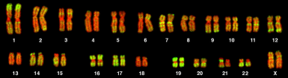
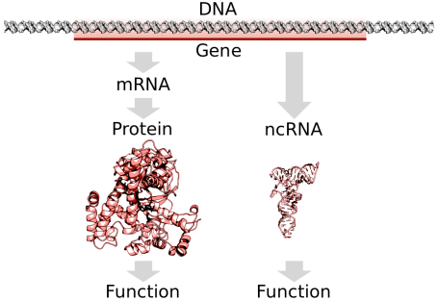
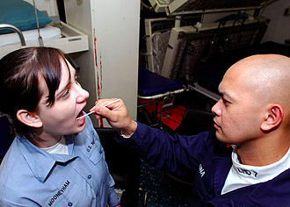
Protecting Life Science Inventions
Challenges for Obtaining Patent: Naturally Occurring Product?
AMP v Myriad Genetics (US 2013) & Ariosa v Sequenom (Fed 2015) ruled that naturally occurring products such as isolated DNA sequences are not patent eligible. Artificial sequences that do not exist in nature, such as a cDNA, are still patent eligible in the US.
After a number of claims have been held invalid, Myriad Genetic breast cancer testing kits are still being marketed in the U.S. New competitors are litigating the case with Myriad (Ambry v Myriad). Some of Myriad’s patents were also invalidated in Europe (via opposition proceeding) and Australia (Sup Australia 2015).
Sequenom provides a non-invasive prenatal test (MeterniT21) for detecting fetal chromosomal abnormalities. The decision of the court to find Sequenom patent invalid raises much concern that patent protections may not be sufficient to support full growth of the personal medicine industry. Creative patent attorneys are needed more than ever to capture unique aspects of gene related inventions.

Slide 35
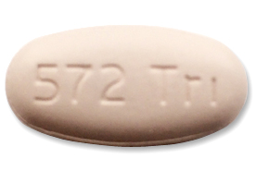
New Drug Development
Why are the prescription drugs so expensive?
Many pharmaceutical companies spend millions to billions USD per new drug development.
One new drug can be extremely valuable, and as valuable as human life is, the society is willing to pay for good pharmaceutical.
Investment = Probability x Return
Industry is characterized by low success rate and high return per success, high cost of research and regulatory development, and low cost for reproduction.
To recoup the high R&D cost, IP is a must.
Company | Number of new drugs (10 years) | R&D per drug (USD Mil)
Pfizer | 10 | 7779
Merck | 9 | 5459
Amgen | 5 | 4270
Source: forbes.com
One month supply of Triumeq, a single dose combination HIV medication: $2,237-$2,422
Source: healthline.com
Source: fda.gov

Slide 36
FDA Approval of Patented Medicine
FDA New Drug Approval Process
  Approval of a new drug is based on the New Drug Application (NDA)
  For approval, applicant must show that the drug is safe and effective for its intended uses, based on a balance between risks and benefits offered by the medication, as well as obtain approval for package insert and manufacturing process. Safety and efficacy are generally shown through large sample clinical data.
Hatch Waxman Act (1984 Drug Price Competition and Patent Term Restoration Act)
  The goal of the Act is to speed up the entry of low cost generics by allowing generic drug producers to challenge weak or invalid drug patents, and to allow brand name producers to recover patent terms lost due to lengthy FDA regulatory approval process.
  Abbreviated New Drug Applications (ANDA)
    Generic drug producers can prove bioequivalence and avoid clinical trials
    Paragraph IV ANDA challenges validity of a drug patent
    Patent owners have 45-days to sue IV ANDA applicant
    180-Day Marketing Exclusivity is awarded for Successful First ANDA Filer
  Patent term extension: Patent owner can obtain up to 5 years of patent term for FDA drug approval delay.
  NDA holder has data exclusivity for 5 years after date of FDA approval of a new chemical entity
  NDA holder has data exclusivity for 3 years after date of FDA approval of a new use of an existing and previously approved chemical entity or new dosage form using the chemical entity
Reverse payment settlement: Brand name producers have sometimes settled with Paragraph IV ANDA generic drug applicants by offering reverse payments.
Consumers cannot benefit from cheap generics if brand name companies “buy out” the generic producers with reverse payments.

Slide 37
FDA Approval of Patented Medicine
ANDA Reverse Payment Settlement / Pay-For-Delay Cases
Federal Trade Commission v. Actavis, Inc (US June 17, 2013)
Solvay Pharmaceuticals produces a patented drug, Androgel. Actavis filed a paragraph IV ANDA, claiming Androgel patent to be invalid. Activis subsequently reached a reverse payment settlement with Solvay, in which Solvay agreed to pay Activis for not marketing its generic versions until 2015.
FTC sued Activis and others for receiving reverse payments to delay the entry of generics.
Supreme Court ruled that reverse payment settlements are not presumptively unlawful as FTC argued, but are subjected to scrutiny under the “rule of reason” including antitrust considerations.
SmithKline v King Drug Co (3d Cir. June 26, 2015) cert Feb 19, 2016
GSK offered Teva that filed a Paragraph IV ANDA against the patent of Lamictal (lamotrigine), instead of reverse payment, an exclusive generic marketing license. A writ of certiorari filed by GSK, seeking to avoid antitrust scrutiny by courts for the settlement arrangement.

Slide 38

Patents: Small Inventors
Patents are a tremendously valuable business tool for small inventors, in that they provide a way to enforce exclusivity.
For a small inventor, they may have an innovative product, service, and/or branding, but without IP protection, competitors are free to duplicate products.
Small inventors may also want to coordinate patents as a business strategy with other forms of protection such as trademark, copyright, and design patent.
Patents give investors an incentive to provide funds and partnering with inventors because they know they will have more control over the market.
Alternatively, Non-Practicing Entities provide a way to monetize inventors’ innovation by providing a moderate return on the inventors’ investment, and then centralize portfolios of patents to negotiate with large companies that use the companies, but on a larger scale.

Slide 39
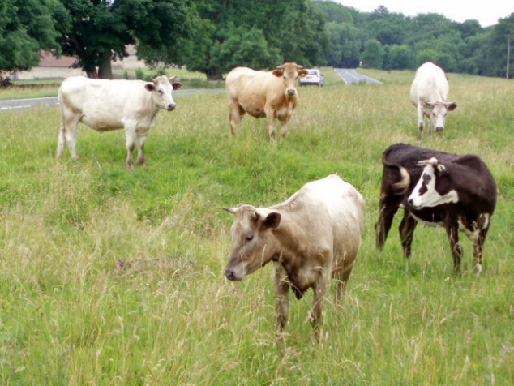
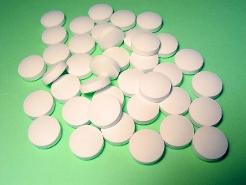
Commercializing Patents for Small Investors?
Road to converting an idea into a commercial product?
Patent Sale
Licensing
University Spin-Off
How?
Showcase Invention at Technology Conferences
Government Grants
Venture Capital Funds
Conduct Private Sector Funded Research
Publicize Invention via Mass Media
Which Application?
Technology that people need and cannot obtain by another method
Technology with low commercialization cost that provides comparative advantage to companies
Other Steps?
Sometimes, companies will copy/reverse engineer technologies after being offered a fair opportunity to license.
In this case, it may be appropriate to threaten litigation to obtain a fair return on investment.

Slide 40

University/Non-Profit Patents?
Non-Profits and Universities Each Annually Spend about $15 Billion in R &D
For example, non-profits may provide grants to researchers whose investigations further the aims of the non-profit.
In addition to their educational mission, universities generally sponsor research by their professors and graduate students.
A grant by a non-profit or an employment contract of a university professor may result in the assignment of all or part of the patent rights based on that grant to fall under the control of the non-profit or university.
Many universities have an in-house patent or IP counsel to help manage the technologies developed internally.
However, because non-profits and universities generally do not have the ability to commercialize the patents themselves, it is often necessary for these types of entities to license or sell the patents.
These entities differ from other Non-Practicing Entities (discussed further below) in that research is a fundamental part of a university’s mission and seeking to fund drug development or cheap technology may be directly related to a non-profit’s mission, so it is important to provide such institutions with a regime that facilitates their ability to recoup their research investments.

Slide 41

Patents: Government
The U.S. Government spends about $125 Billion annually in R&D Funding (Source, AAAS).
This funding is split roughly evenly between defense and nondefense research, and represents about 0.8% of GDP and about 4% of the Federal Budget.
Major R&D Agencies include AARA Research, USDA, DOD , NASA, DOE, NSF, and NIH.
The government also funds R&D though grants, contracts, cooperative agreements, and other types of “funding agreement(s).”
However, government funding can cause the government to have partial control over patents acquired using government funds.
At a minimum, the government usually receives a license to use technologies it funds.
Legal authorities such as the Federal Acquisition Regulation (FAR) and the Defense Federal Acquisition Supplement (DFARS) govern the rights the government has to research it helps fund.
Government funding may reach beyond the patents for which it was specifically used; While government funding can be a great way to get financial support for research, it is important to consider carefully the impact of such funding on patents that are wholly or partially supported by such funding.

Slide 42
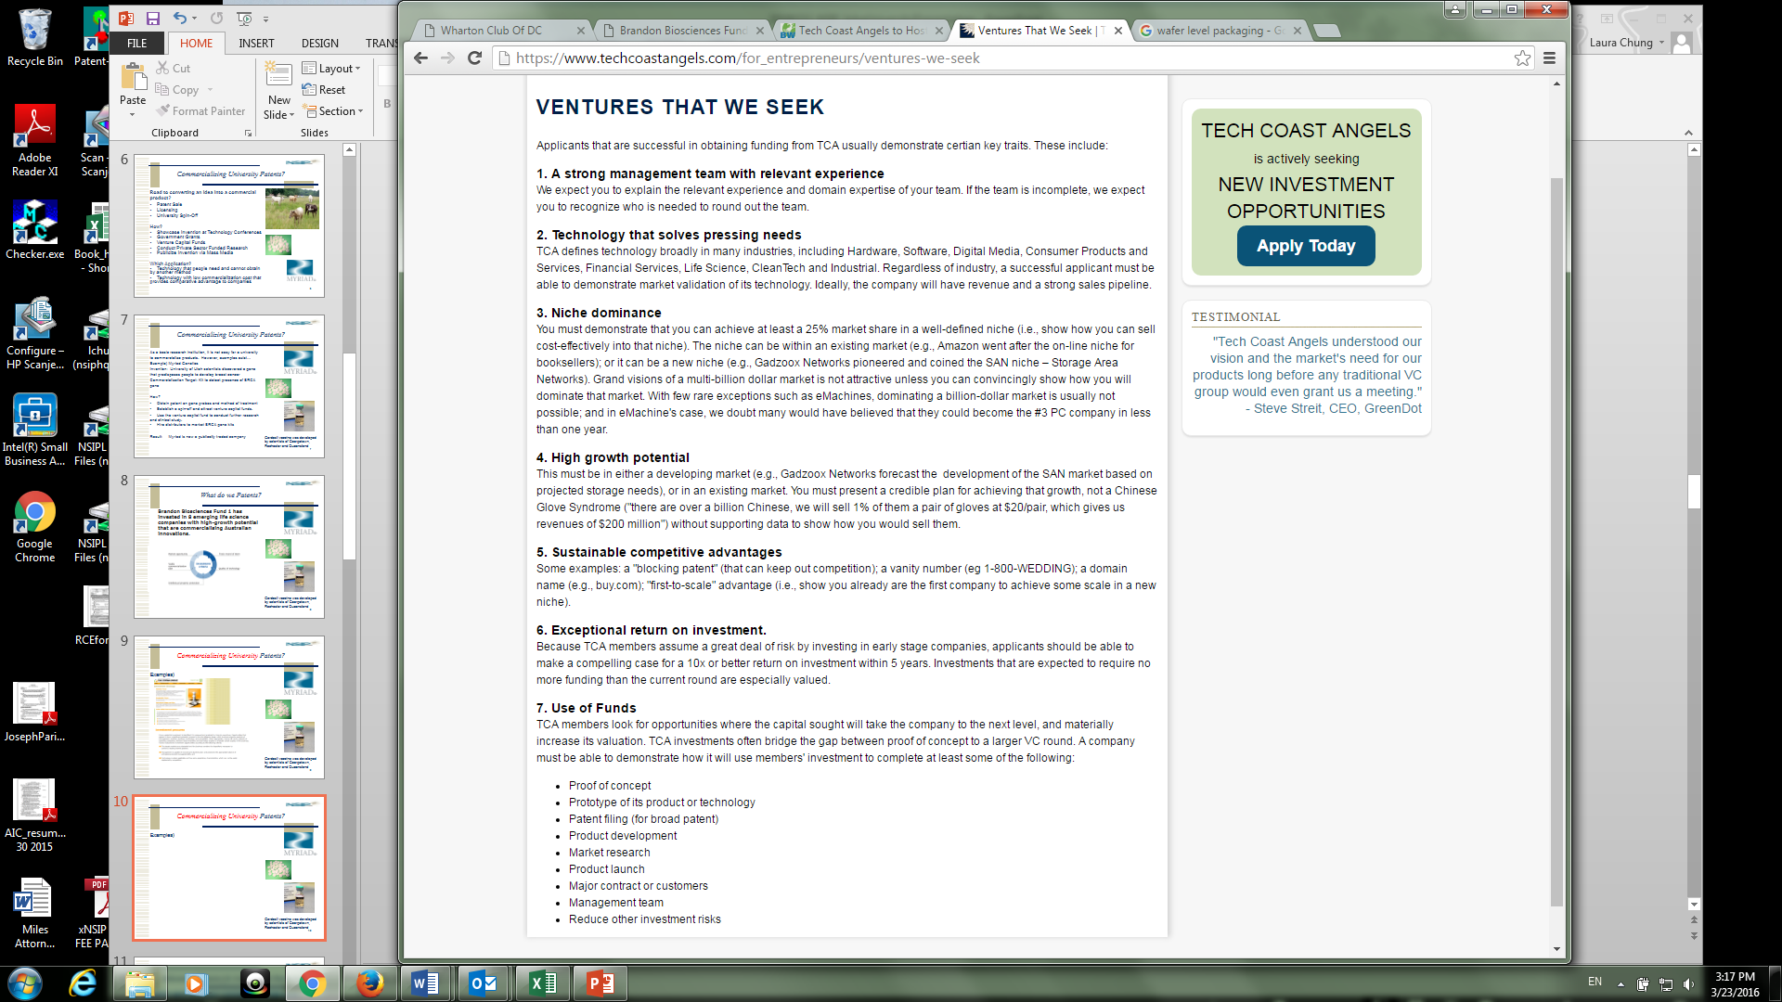
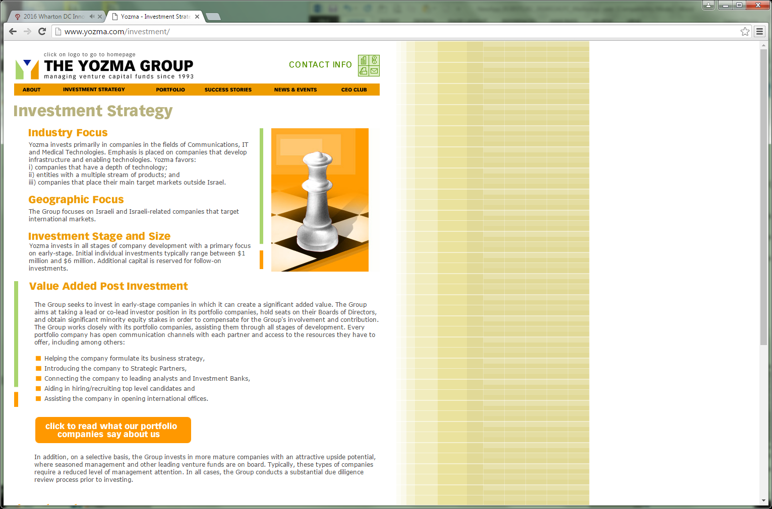
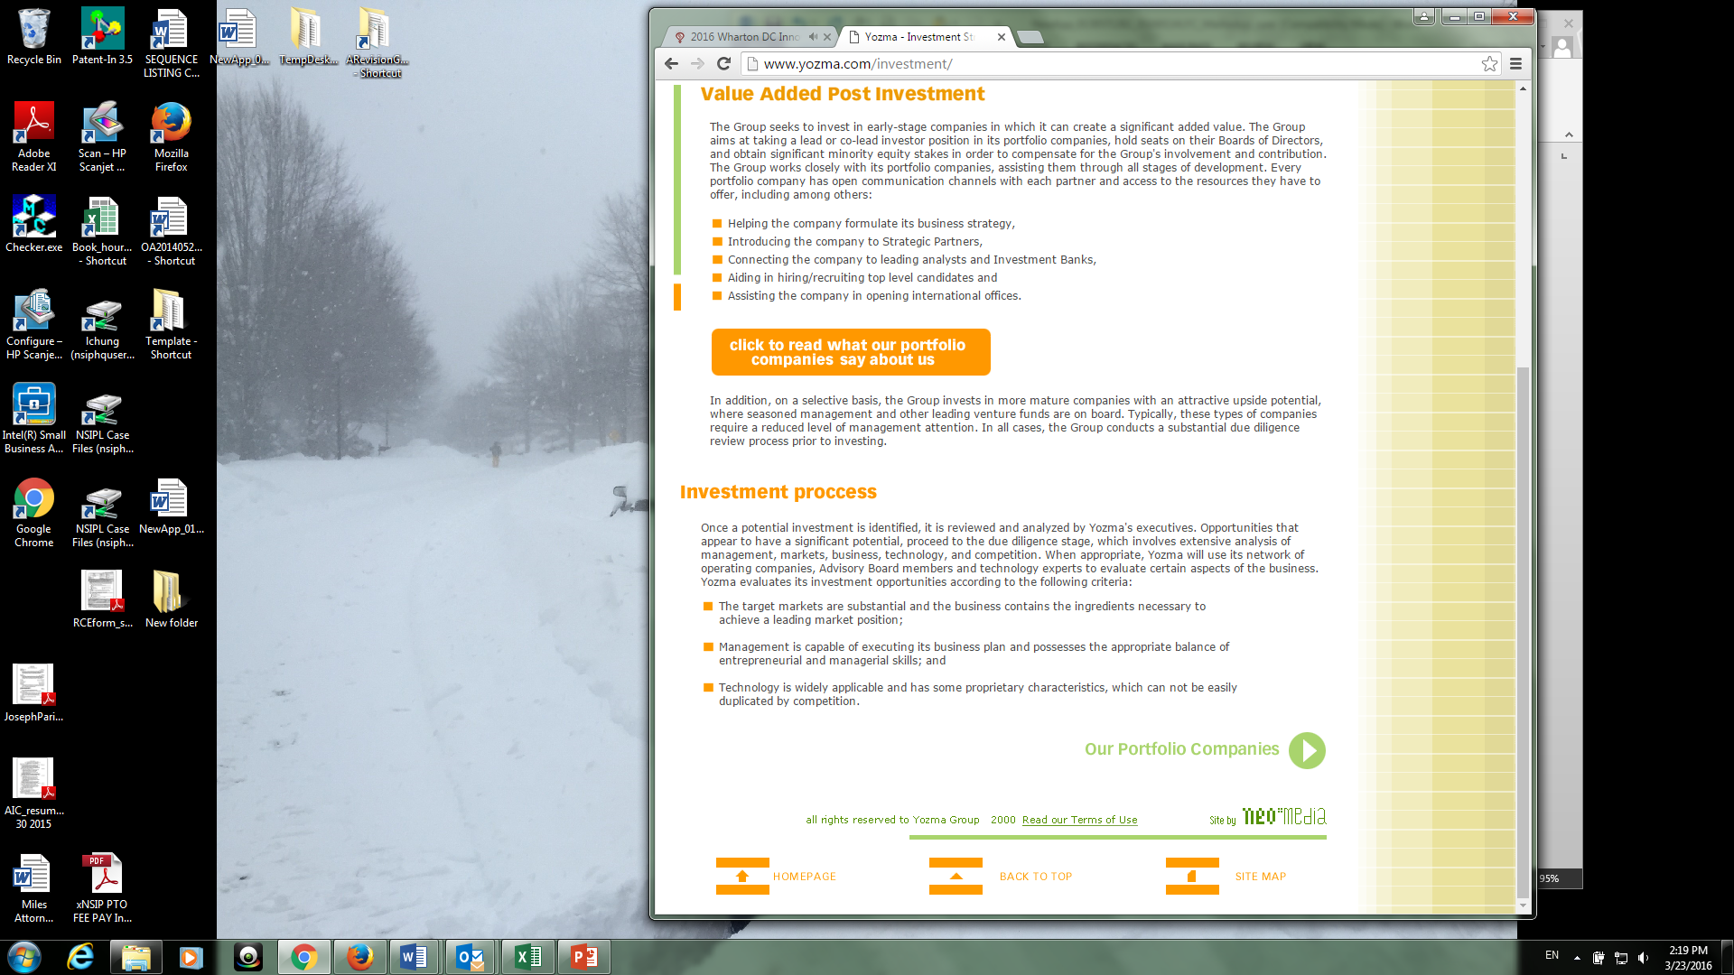
Perspectives on Patents: Venture Capitalists/Investors/Non-Practicing Entities
Investors are looking for businesses that can provide sustainable competitive advantage.
Patent provides competitive advantage that is not easily duplicated by competitors.
Ex) What Yozma Venture Group & Tech Coast Angels
look for before placing their money
on the table:

Slide 43
Perspectives on Patents: Venture Capitalists/Investors/Non-Practicing Entities
Non-Practicing Entities (NPEs) allow inventors to exercise their patent rights when they have no capability to manufacture products.
Ex) Intellectual Ventures, Lemelson patents,
NPEs are sometimes referred to as “patent trolls” because they do not invest resources in commercializing products but sue companies that produces products.
Theory: Some people are able to predict what will become valuable in the future, file patents and capitalize on the paper patents after another commercialize the invention. Jerry Lemelson filed more than 600 patents, and litigated some to collect royalties over $1 billion.
USPTO, legislature and courts have looked for ways to decrease influence of NPEs while preserving the rights of legitimate small inventors. Certain fields, such as business method and software industry are especially prone to attack by NPEs. No solution has been found for selective remedy.
NPEs sometimes invents themselves, other times buy inventions from small inventors or sue on their behalves. NPEs note that established corporations sometimes ignore small inventors until being sued.
The patent system rewards the first inventor who files a patent, whether or not he or she has the resource to manufacture the product.

Slide 44
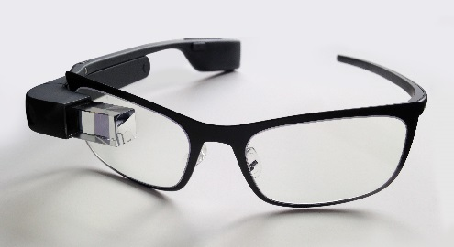
Patents: Large Corporations and
Established producer?
Why Established Producers Maintain a Patent Porfolio?
Sustainable Competitive Edge: The U.S. fortune 500 companies compete internationally in a newly trade liberalized market. The GDP of residents of the U.S. is higher than that of many other countries, which makes U.S. produced products more expensive. The competitive edge has to come from producing high-tech / high-quality product that others cannot produce or is protected by IP rights. R & D cost must be recouped by maintainable proprietary interest.
Negotiation Chip: Large corporations can be sued by other producers in similar fields. To leverage settlement, the corporations keep a large portfolio of patents that can be used in counterclaim lawsuit (Samsung v Apple). Further, cross licensing prevents lawsuits in advance.
Defensive Patenting: If someone else patents before you, the other person may keep you from practicing your invention, either by excluding you at the border (ITC) or filing a lawsuit inside the U.S.
Google Glass D659741 S1

Slide 45

Recent Developments (Domestic)
Congress
The AIA (America Invents Act) of September 16, 2011 was a major step by Congress to update the Patent System as a whole; it is now fully implemented
Pending before the 114th Congress are the:
  PATENT Act (S. 1137) & Innovation Act (H.R. 9)
  VENUE Act (S.2733)
  Trade Protection Not Troll Protection Act (H.R. 4829)
  STRONG Act (S. 632)
  TROL Act (H.R. 2045)
  Demand Letter Transparency Act of 2015 (H.R. 1896)
  Innovation Protection Act (H.R. 3349)
These bills are designed to accomplish various tasks. The main goals of the bills are to change litigation procedures to avoid frivolous lawsuits, especially by NPEs (non-practicing entities) who would abuse the system by filing lawsuits based on invalid patents, while protecting the value of patents for legitimate patentees. Different parties have different interests, and hence would like to modify the system to their advantage.

Slide 46
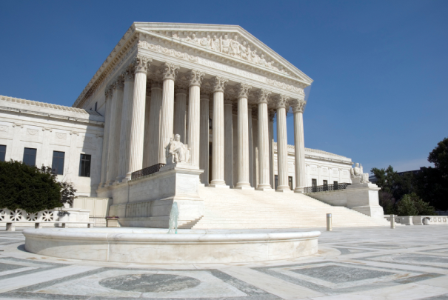
Recent Developments (Domestic)
Federal Courts
The Supreme Court has issued several major patent opinions recently:
  Kimble v. Marvel (2015): Post-Patent Expiration Royalties
  Commil v. Cisco (2015): Belief in Validity as a Defense
  Teva v. Sandoz (2015): Review of Factual Matters in Claim Construction
  Alice v. CLS Bank (2014): Restrictions on patentable subject matter directed to an “abstract idea” without “significantly more”
  Nautilus v. Biosig (2014): Reasonable certainty standard for indefiniteness
  Limelight v. Akamai (2014): Divided Infringement for Inducement
Cases granted Cert:
  Cuozzo Speed Technologies v. Lee: Consideration of IPR Rules
  Samsung Electronics Co. V. Apple: Design Patent Damages
  Stryker Corp v. Zimmer and Halo Electronics, Inc. V Pulse Electronics: Willful Infringement
Various Case are Awaiting Cert Decision

Slide 47
Recent Developments (Domestic)
Federal Courts
The Federal Circuit is the Federal Court that hears initial appeals from District Court decisions, and specializes in patent decisions. The Federal Circuit’s decision act as precedent unless overruled by the Supreme Court. The Federal Circuit also applies Supreme Court decisions to build a body of case law for use in interpreting Supreme Court decisions.
Individual cases are presented to District Courts, certain of which have “Rocket Dockets” that specialize in patent cases and hear the cases relatively quickly, such as certain courts in Texas, Virginia, California, New York

Slide 48
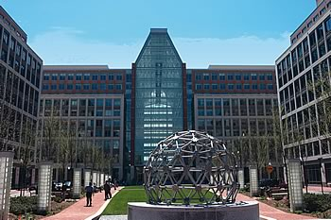
Recent Developments (Domestic)
USPTO
The PTO has initiated many initiatives to improve Patent Quality.
The PTO has been evolving improved guidances/policies to deal with certain aspects of the AIA and case law.
With respect to 35 U.S.C. §101, the Alice case and other related decisions before the Federal Courts and the PTAB has led to guidelines with a two-part test for eligibility and various examples. However, this area is still in a state of flux and skilled attorney work is necessary to manage this issue.
With respect to the AIA, the USPTO has implemented transitioning to First-Inventor-to-File.
The USPTO has also implemented Post-Grant Proceeding that allow defendants to challenge asserted patents before the PTAB.
This has created a need for skilled representation in these proceedings; Also this has made it extremely important to invest sufficient resources and time into the initial patent process to maximize their ability to withstand challenges and be as valuable as possible.

Slide 49


Recent Developments (Domestic)
USPTO
The USPTO has also been evolving policies on “functional” claiming (“means for”) claiming, which is often used in computer and software-related claims.
The USPTO has also been evolving policies related to the Broadest Reasonable Interpretation (BRI) and Plain Meaning claim standards
The USPTO has also released guidelines related to Enablement and Written Description standards.
The USPTO has also released guidelines related to Obviousness and Best Practice Under Examination.

Slide 50
Recent Developments in
International Intellectual Property Law
Patents were not always considered a Trade Issue
But now they are necessary for International Trade
Trend towards Open Market Access and Greater for IP Rights:
1883: Paris Convention provides a convenient way for filing a patent in multiple member countries and secures national treatment for patent applications filed by a foreign applicant.
1916: US Tariff Commission (now ITC) created to protect domestic industry from unfair competition
1947: General Agreement on Tariffs and Trade (GATT) reduced tariff for member states, and paved the road for establishment of WTO
1970: Patent Cooperation Treaty (PCT) provides a unified patent filing procedure for contracting states.
1995: WTO established (now includes 160 member countries)
    Trade-Related Aspects of Intellectual Property Rights (TRIPS) came into effect as a part of WTO agreements, setting down minimum standards of IP protection in WTO member countries.

Slide 51
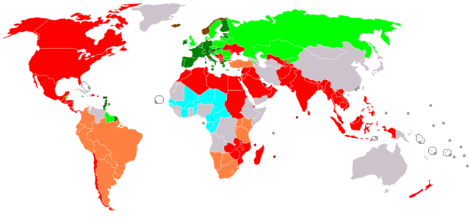
International Economic Integration
Free Trade Agreement (FTA) = an agreement between countries to form a region of trade area in which goods and services can move freely with a reduction or a total elimination of tariffs, import quotas, and other trade barriers.
More than 200 free trade agreements and custom union treaties have been signed since early 1990s, forming a complex network of free trade regions where tariff and other trade barriers are essentially eliminated.
FTA with US: Korea, Colombia, Panama, Australia, Chile, Singapore, Peru, Oman, Morocco, Bahrain, Israel, Jordan, NAFTA (Canada, Mexico)
Dominican Republic–Central America Free Trade Agreement (Costa Rica, El Salvador, Guatemala, Honduras, Nicaragua, the Dominican Republic)
TPP (Australia, Brunei, Canada, Chile, Japan, Malaysia, Mexico, New Zealand, Peru, Singapore, Vietnam)
2002 European Union established
2010 Eurasian Customs Union
US formed free trade agreements with 25+ countries
1994 – NAFTA
1995 – TRIPS
2000 – Doha
2004 – Australia-U.S.
2011 – Korus
2016 - TPP
Economic Union (green), FTA Areas (red), Customs Union (orange, blue)

Slide 52
US Businesses need IP for Trade
US requested:
  Stronger intellectual property protection
  Enforcement of pharmaceutical patents
  Court system to challenge violations of intellectual property rights
In exchange of providing:
  Open Market Access
  Attract Foreign Investment
Industrialized countries export “Intellectual Property”
US Exports:
  Agricultural products
  Electronics
  Semiconductor machinery, aircraft
  Music, movies
  Medicine
  Services
US Businesses must keep out knock-off products from entering US and being marketed abroad

Slide 53
Building International Patent Portfolio
To seek patent protection abroad, a patent must be obtained in each country where protection is sought.
Two different ways exist for obtaining patents in other countries.
Foreign Filing under Paris Convention
  Within 12 months of filing in USPTO, file multiple applications in Paris Convention countries claiming priority to the US application.
PCT System
  Within 12 months of filing in USPTO, file a PCT application in a PCT Receiving Office (USPTO), or file directly in the Receiving Office. Enter international stage in PCT countries within 30 months of the first filing date.

Slide 54
Building International Patent Portfolio
  PCT System
    Within 12 months of filing in USPTO, file a PCT application in a PCT Receiving Office (USPTO), or file directly in the Receiving Office. International Search Report
    Receiving Office prepares an international search report indicating your chance of obtaining a patent. You may amend your claims before going forward.
  National Phase
    Within 30 months from the first filing date, enter national stage in each PCT countries to obtain patent in each country. Costs for translation, legal service and government fee can be delayed to this point.
  Costs:
    Patent drafting cost (2000-8000 USD)
    Filing fee for using USPTO (1363 USD)
    Search fee USPTO (2080 USD), Israel 912 USD
    Translation fees
    US and foreign attorney service
    Maintenance fees (3/7/11) / Renewal fees (200-2000/yr)

Slide 55
Building International Patent Portfolio
  Which country to file?
    Will you sell / import your product into this country?
    Market size?
    Do they have manufacturing capacity?
    Do you have competitors in this country?
    Can they produce counterfeit products?
    Is translation expensive?
    How long does it take to patent grant?
    Is it difficult to enforce patents in this country?
  Commonly filed states for:
    Electrical / High Tech: EPO, Korea, Japan, India, China, Canada, Australia, Brazil
    Pharma: EPO, Canada, China, Japan, Mexico, Korea, Australia, India, Israel, Singapore…

Slide 56
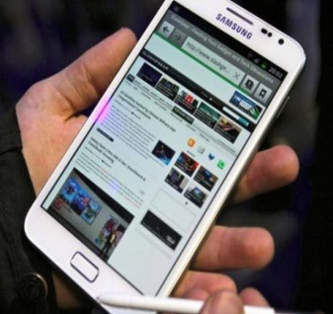
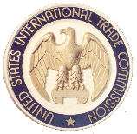
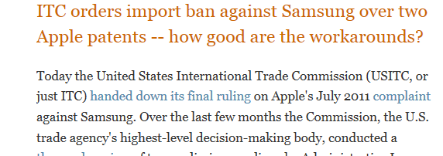
Preventing Importation of Infringing Products
US Customs
  Regulates what comes into the US and US borders.
  Developed countries actively keep out patent infringing products at their borders.
US ITC
  Adjudicates on patent related issues to protect domestic industry according to 19 U.S.C. 1337 (Tariff Act of 1930)
  Stops importation at the border
  No monetary damages (unless Federal courts)
56

Slide 57
ITC Section 337 Litigation
  Independent, quasi-judicial federal agency, and an alternative forum for patent infringement
  Purpose of Statute: To prevent importation into the U.S. articles that infringe intellectual property rights
  Presides over patent, trademark and copyright violation, theft of trade secret, trade dress misappropriation, false advertising, that destroy or injure the domestic industry, prevent establishment of such industry, or retrain or monopolize trade (Tariff Act of 1930 Section 337)
  Remedy: (in rem jurisdiction over imported articles)
    Exclusion orders enforced by the U.S. Customs to
    keep articles from entering the U.S.
    Cease and Desist Orders enforced in the U.S. to
    prevent illegal sale of products from outside
    Duration is for the life of the patent (for patent infringement)
  Complainant must establish Domestic Industry:
    Showing of a significant economic investment or employment in the U.S.
    Showing of a valid enforceable patent practiced by the complainant
  Speedy Resolution: 16-month investigation with full discovery, hearing and review
0 month – complaint filed
2-9 month – discovery
9 month – hearing
12 month – initial determination
14 month – decision on petition for review
16 month – final determination
18 month – appeal to Federal Circuit

Slide 58
A Global Patent Monetization Strategy
Find Local Partners:
Do you want to manufacture in this country?
Do you want to import finished products?
Do you need a local distributor? Does your product require servicing?
Your Options:
Set up a branch
Assign your patent to a local manufacturer
Grant an exclusive-license to a local company
Grant multiple non-exclusive licenses
Set up a joint venture or partnership with a local company
Manufacture in your country and find locate distribution channels in the target country.
58

Slide 59
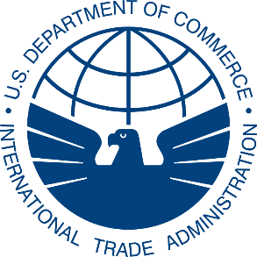

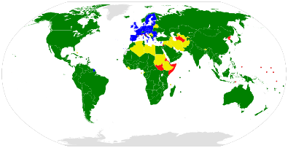
A Global Patent Enforcement Strategy
Your Patents are Infringed?
Using Foreign Courts
  Select best countries to bring in litigation:
    Market size, scope of your patent claim, speed of litigation, political and legal climate, pro-patent courts or anti-patent courts, how fast is the proceeding, etc.
Using Administrative Proceedings
  Are administrative proceedings such as an opposition proceeding available in the country?
Using International Treaties
  Any arbitration or forums provided in free trade agreement, investment treaties, etc.?
Using U.S. Government
  US Office of Intellectual Property Rights provides information regarding remedies available in each country.
  US Trade Rep may be able to able to initiate a WTO dispute settlement proceeding, or put pressure using Special 301.
59

Slide 60
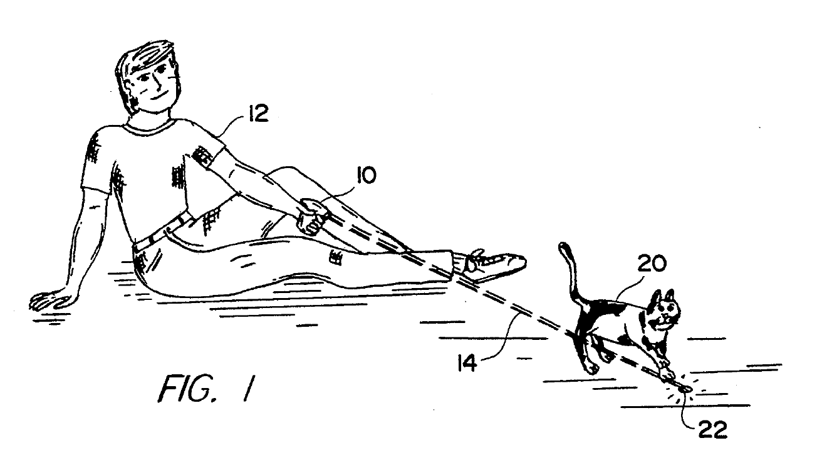
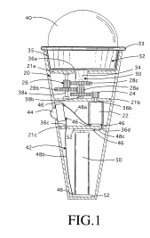
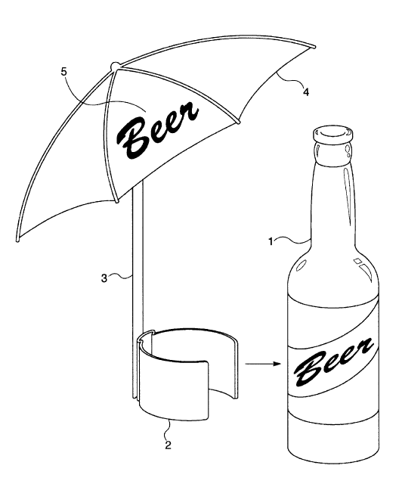
Funny patents
Method of Exercising a Cat (5,443,036)
Beerbrella (6,637,447)
Motorized Ice Cream Cone (5,971,819)
60

Slide 61


Questions?
Your Presenters:
Laura Chung (lchung@nsiplaw.com) & Jonathan Schlaifer(jschlaifer@nsiplaw.com)

